Slide 1
09/03/15
JRC – POLICY LAB PILOT
INTRODUCTION TO PECHA KUCHA AND SPEED PRESENTATION SESSIONS
STRATEGIC DESIGN SCENARIOS

Slide 2
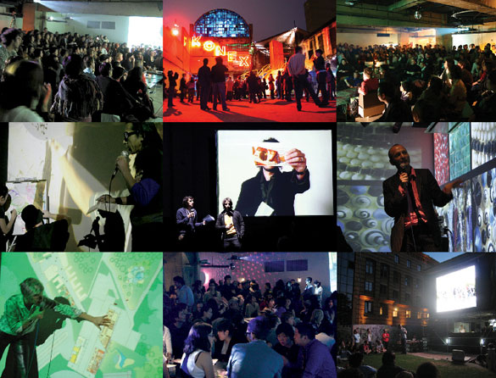
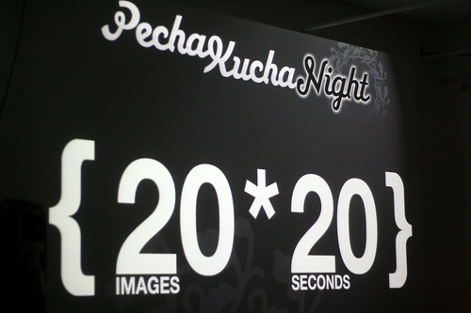

Slide 3
PECHA KUCHA
BASIC PRINCIPLES
20 slides x 20 seconds per slides (20 participants at 20:20 the 20th of the month…)
short, light and entertaining sessions… (DJ composing different presentations…)
more adapted to review art-like portfolios or to propose narrative (20 sec. not more not less…)
STRATEGIC DESIGN SCENARIOS

Slide 4
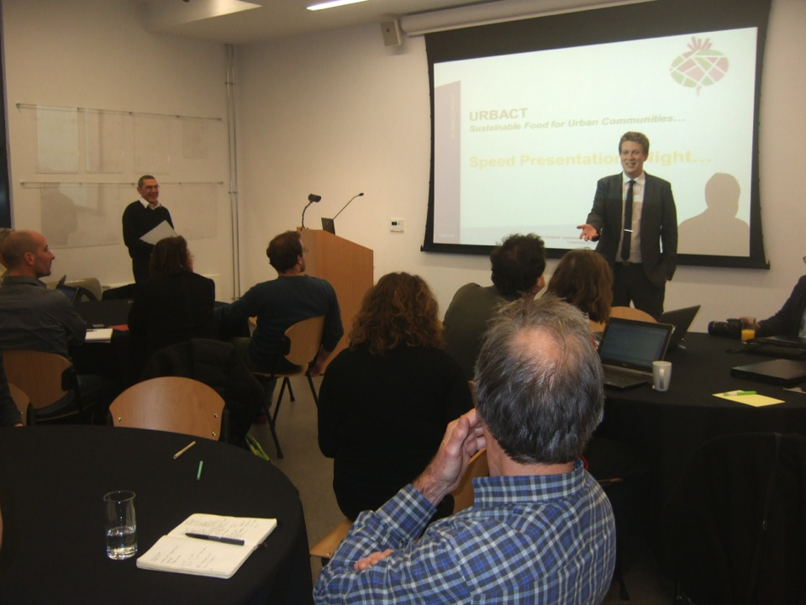

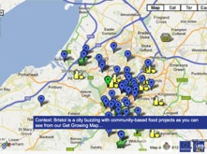





Speed Presentation Night…
3 slides x 3 minutes…

Slide 5
SPEED PRESENTATIONS SESSIONS
BASIC PRINCIPLES
3 slides / 3 min. (strict overall time limit but speaker change slide when it is convenient in the discourse)
presentation template (i.e. for light case studies or projects: context / innovation / benefits)
slide template (i.e. title + large image + 2 lines of explanation)
Possibility to use the slides autonomously in a light exhibition
Possibility to videotape the speed presentation sessions and get easily short and easy to watch series of videos.
STRATEGIC DESIGN SCENARIOS

Slide 6
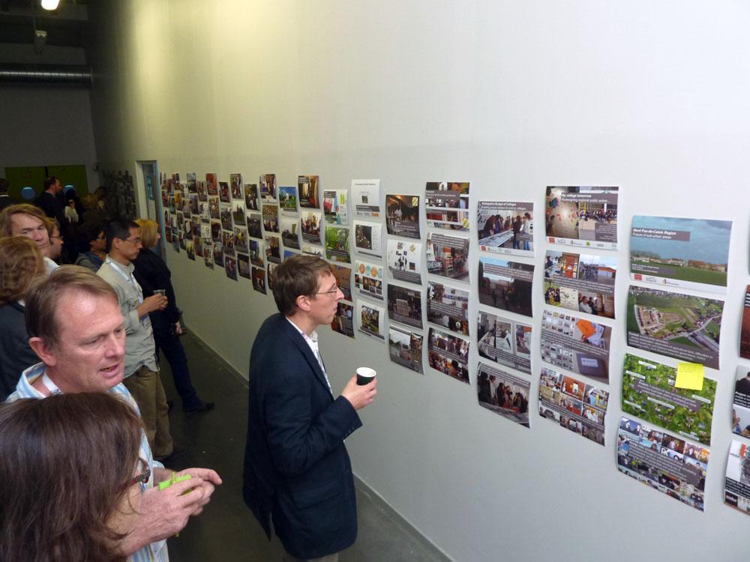

Slide 7
SPEED PRESENTATIONS SESSIONS
DESIGN FOR JRC
(1 slide/1 min. ) x 8-10 per participants?
template design of the slide?
images or videos (printed version of the video?)
core team prepare and share some examples?
more…?
STRATEGIC DESIGN SCENARIOS

