Slide 1
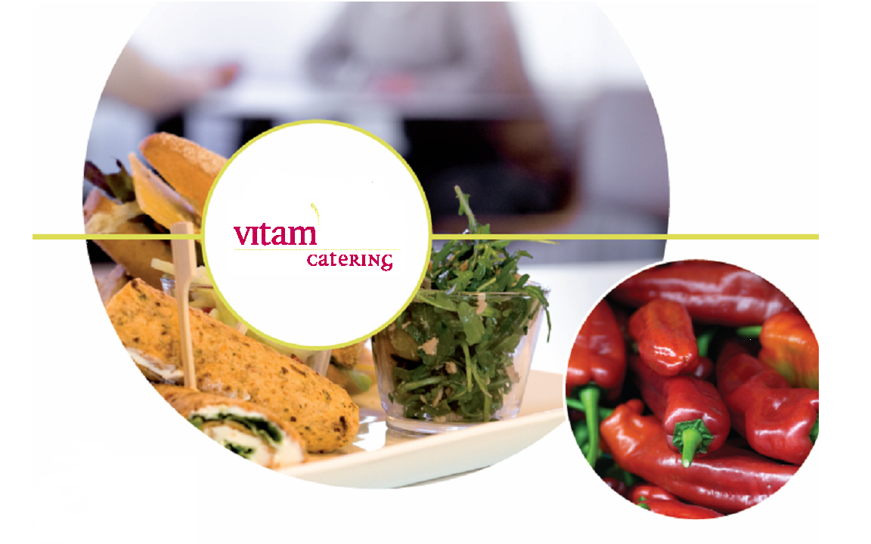
Municipality of Amersfoort, 23 april 2013
Pauline Gerritzen
Maaike Liefkens

Slide 2
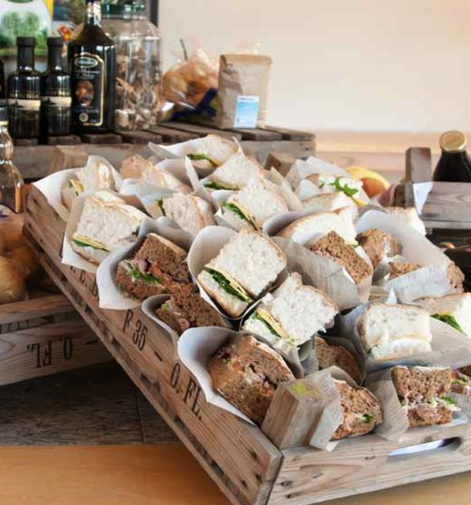
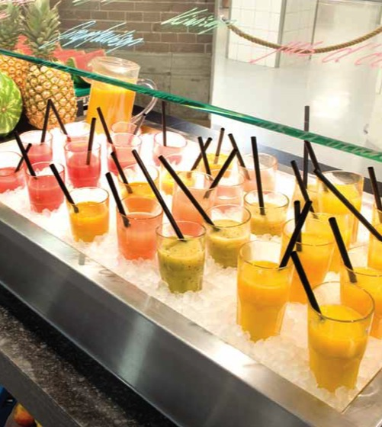

Introduction to VITAM
Founded 10 years ago
More than 300 staff and over 70 restaurants. Broad customer range: financial industry, law offices, municipalities, media organizations etc.
Demand alot of ourselves. Always looking for the best ingredients and suppliers.
Food with integrity and a company with a heart.
VITAM believes that F&B meeting points
should be a moment of joy and relaxation.
  Satisfied guests isn’t enough!

Slide 3
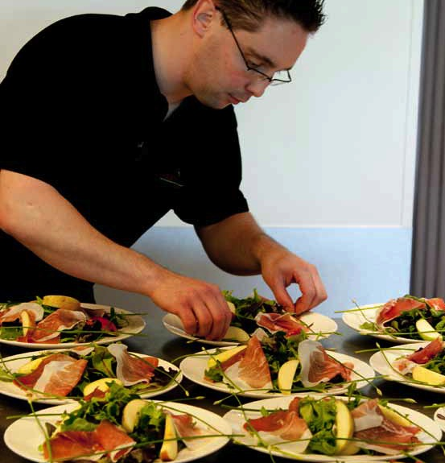
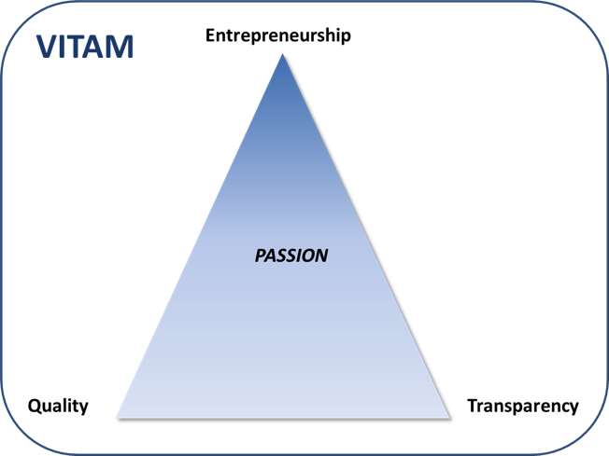
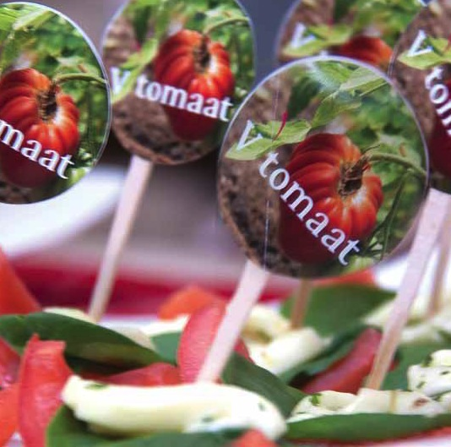
What makes us unique?
Strategy is based on three pillars:
Entrepeneurship
Quality
Transparency (well-being of people & nature)

Slide 4
1. Entrepreneurship
VITAM restaurant managers are entrepeneurs.
Decentralized structure
  No fixed menus or central procurement from headquarters.
  Allows flexibility. Pea soep in May? No problem!
Demands certain skills of our people
  Creativity. Love for other people. Listening skills.
  V’Academy.
Demands a different company structure and quality systems to support this.

Slide 5
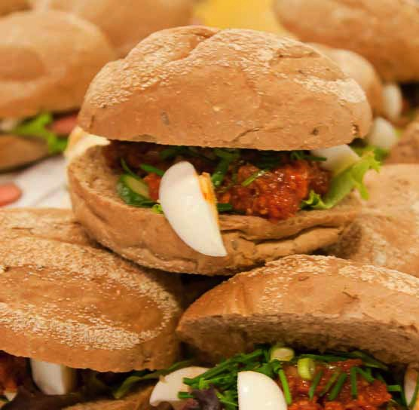
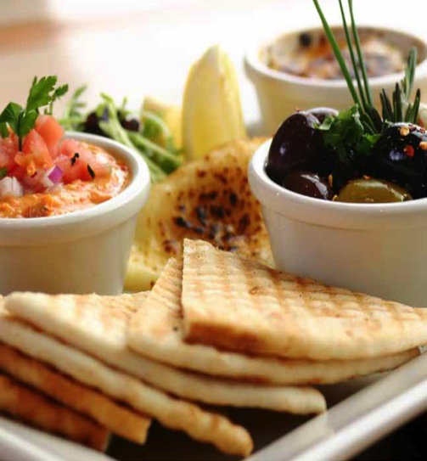
2. Transparency
Problems in de Dutch food chain: battery hens, horse meat and flu’s.
  Demand for transparency is increasing
  Information needs about production and heritage rise
  More control over what we eat & drink
  Making better choices
VITAM defines transparency as a means to make sustainable consumption and production possible.

Slide 6

2. Transparency, how do we do this?
No time to waste program
  Important objective = tangability.
  V’Ketchup => reducing food spillage.
  Freshly sliced meats and cheese instead of prepackaged (300 garbage bags!)
Freshmarket
  = productextension. Organic and sustainable (local) products for home-use.
Notes:
Disapproved tomatoes
Most caterers are buying abroad, we choose to buy local

Slide 7
Local produce (regional products)
  Most caterers are looking abroad, not VITAM.
  Find the best producer with the best, most fresh and most delicious taste.
  Result: higher quality, better food safety (origin known), seasonalcooking, affordable luxury and support for local farmers.
Productgroup | Product | % Local produce
Dairy | Milk Cheese | 89 % 76 %
Meats, fish and poultry |  | 60-65 %
Fruit & Veggies | % varies with the seasons | 40 %
Bread | Bertram organic | 100%

Slide 8
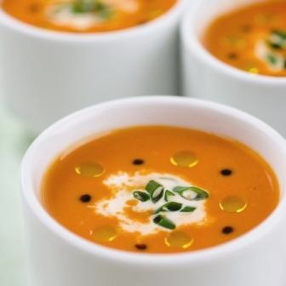
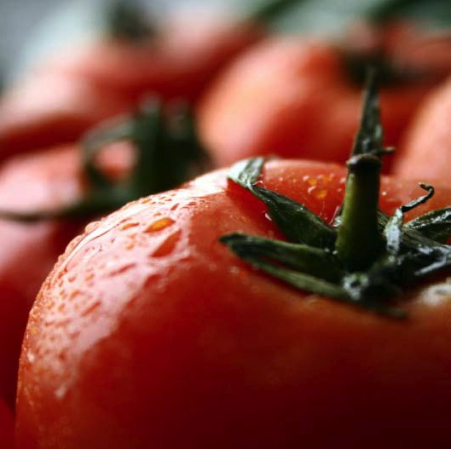
    MijnBoer delivered to the door. Not feasible, now part of Sligro.
Regional weeks. Objectives:
  6x/ year, 1 week 3 dishes
  Region linked with seasons
  Insight in regional buying and distribution
  Identity of the region, facts and traditions, travel guides, Fresh market…
Transparency pilot, 200 guests. Objectives:
  How does transparency work in real life?
  What does this demand from our suppliers?
  Are our guests interested?
  How do we make it tangible?
Notes:
10 transparencies for suppliers
Travelling domestically

Slide 9
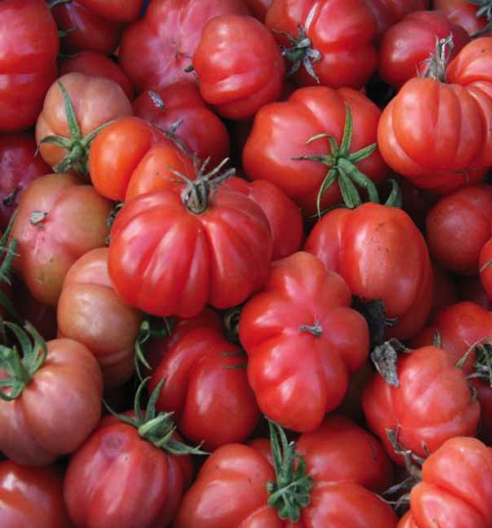
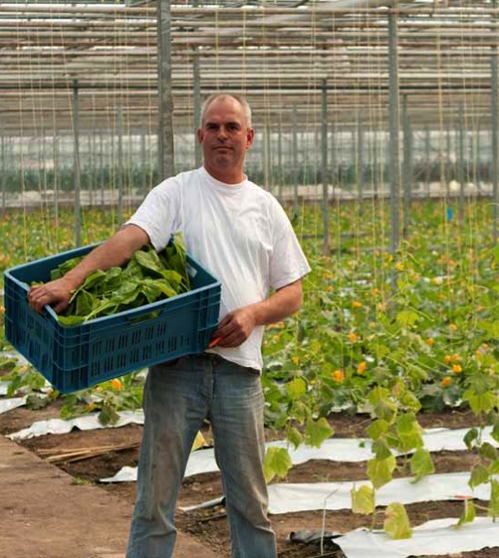
In a nutshell: VITAM and transparency…
Seasonal cooking
No fixed menu’s, decentralized
> 60% fresh prepared
Local produce
Fresh baking of bread (croutons)
Quality control essential…

Slide 10
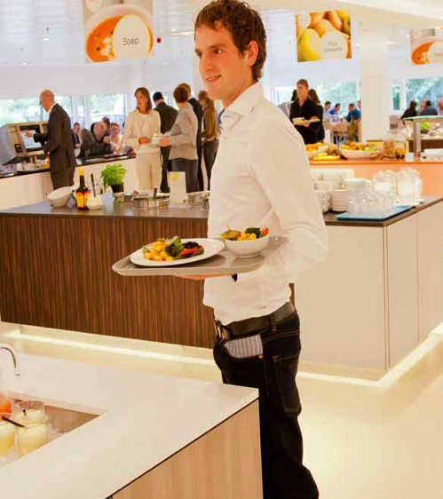
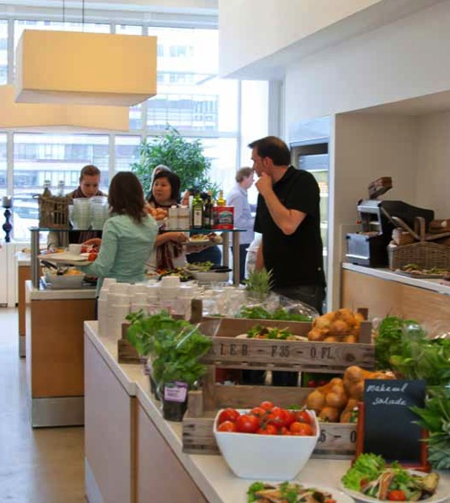
3. Quality
Training VITAM’ers (cooking masterclasses, V’Academy etc.)
ISO norm (guarantees optimal business practices)
Energy label A and B (cultivation and transport)
Climate neutral group. CO2 emission.
V’Compass
Environmental statement (cleaning products, transport, waste collection etc.)

Slide 11
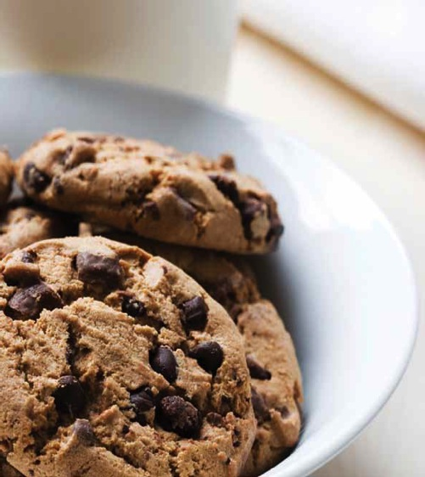
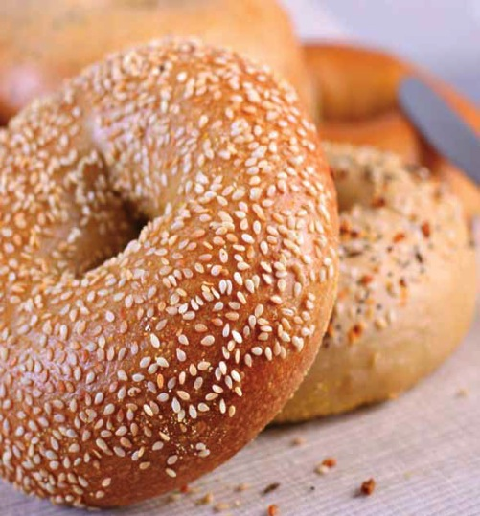
Don’t believe me…
take a look yourself…

