Slide 1
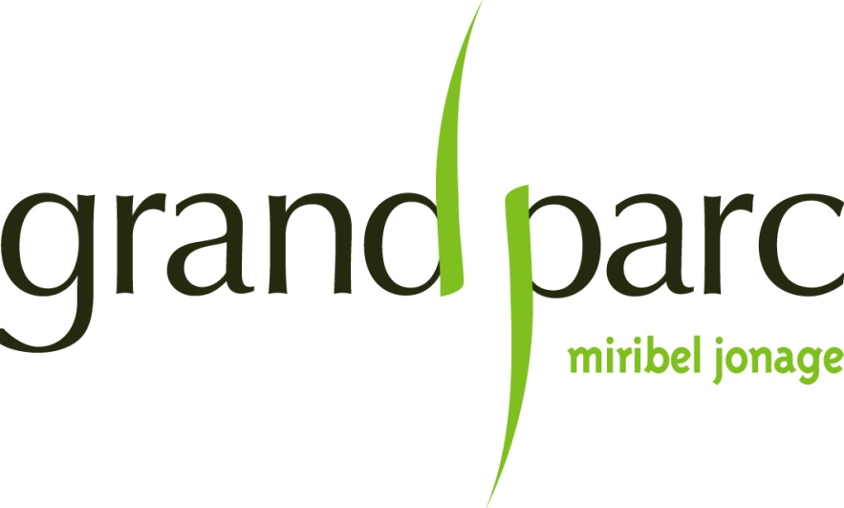
Grand Parc agricultural project
URBACT
04/06/2014
Notes:
Presentation of how the talk will progress

Slide 2
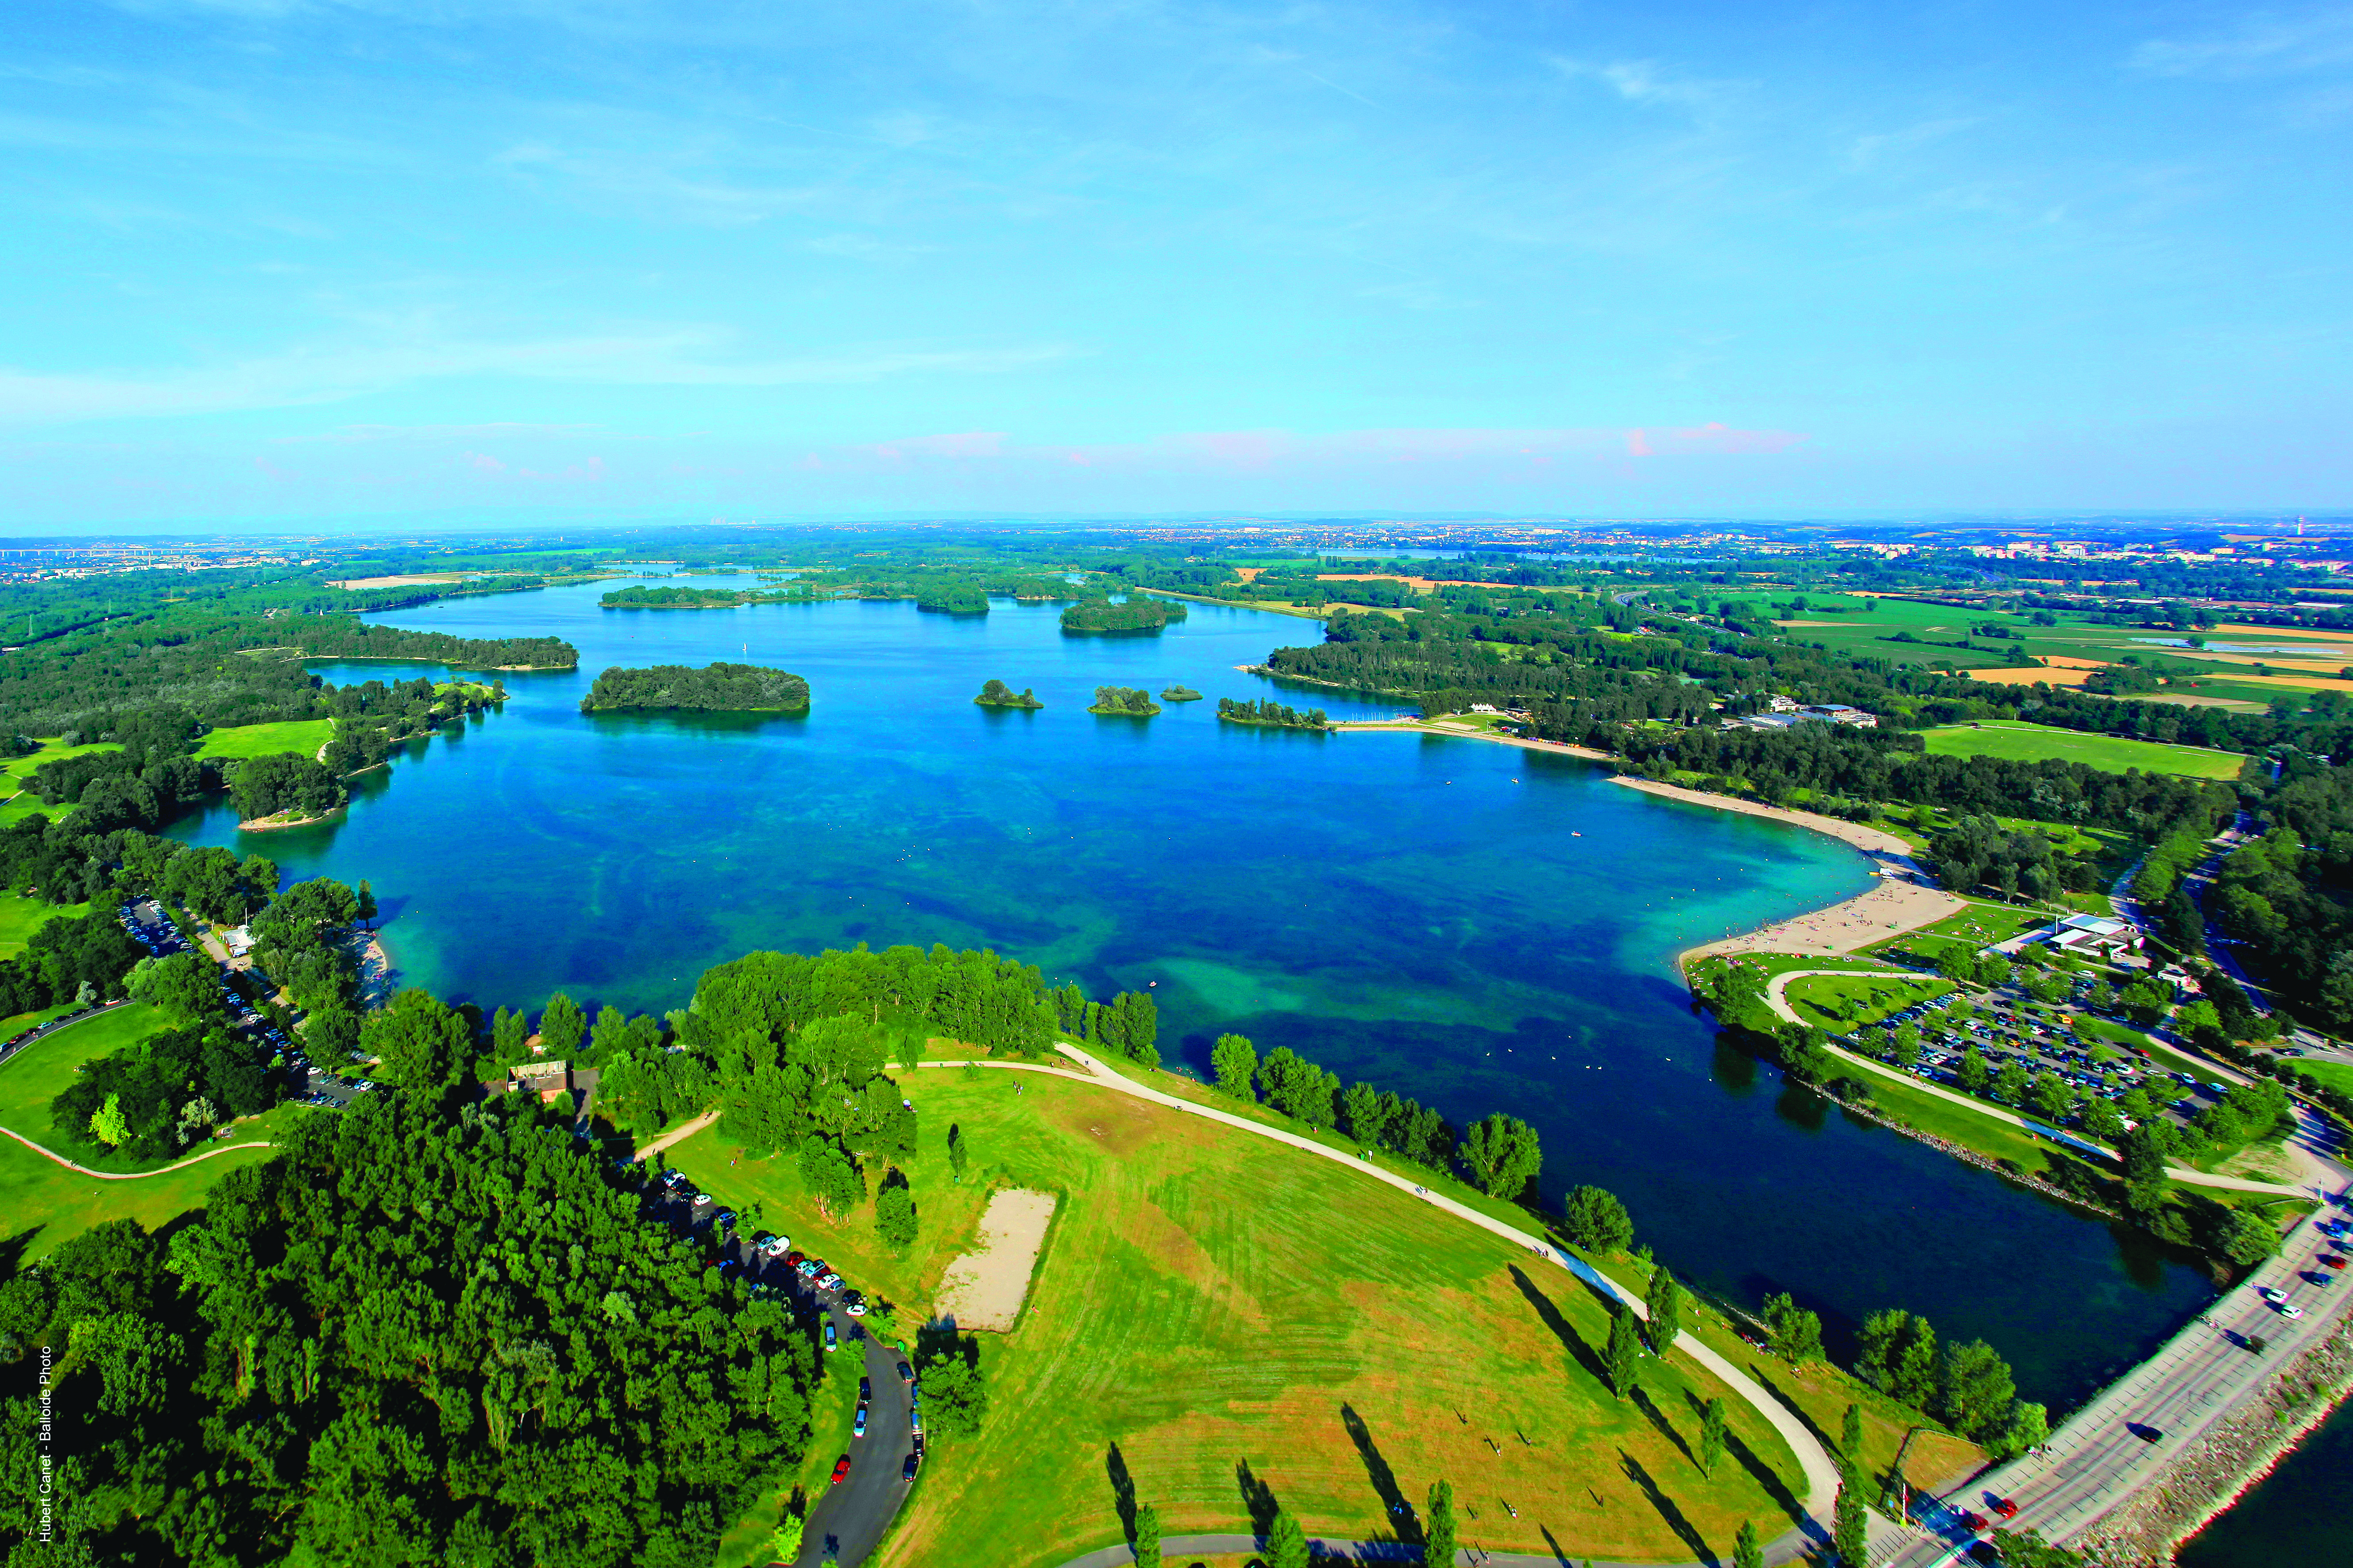
Grand Parc, a very special setting
5,400 acres ( 2 200 ha)
11 riverside towns and villages
Lyon, Villeurbanne,
Grand Lyon,
2 departments of France
9 miles from Lyon city centre
2nd largest urban nature park

Slide 3
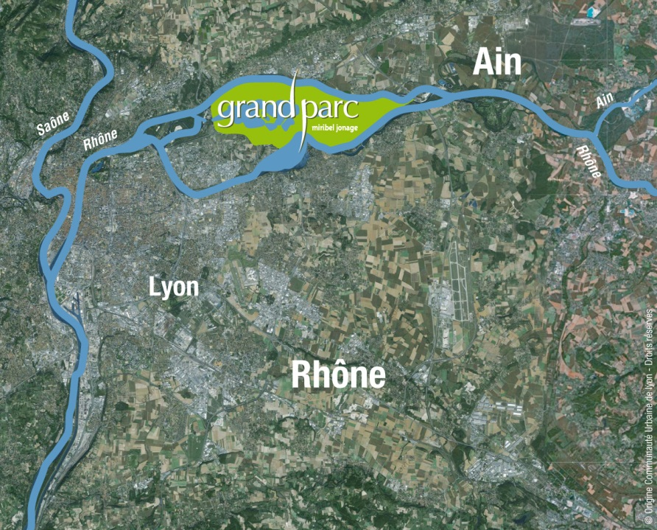
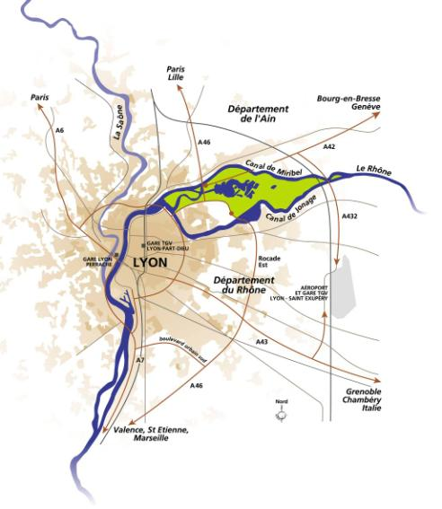

The Grand Parc at the confluence of rivers
Notes:
A history with close ties to the river
- Before 1850: the river in its natural state
- Beginning of 20th century: the river is channelled

Slide 4
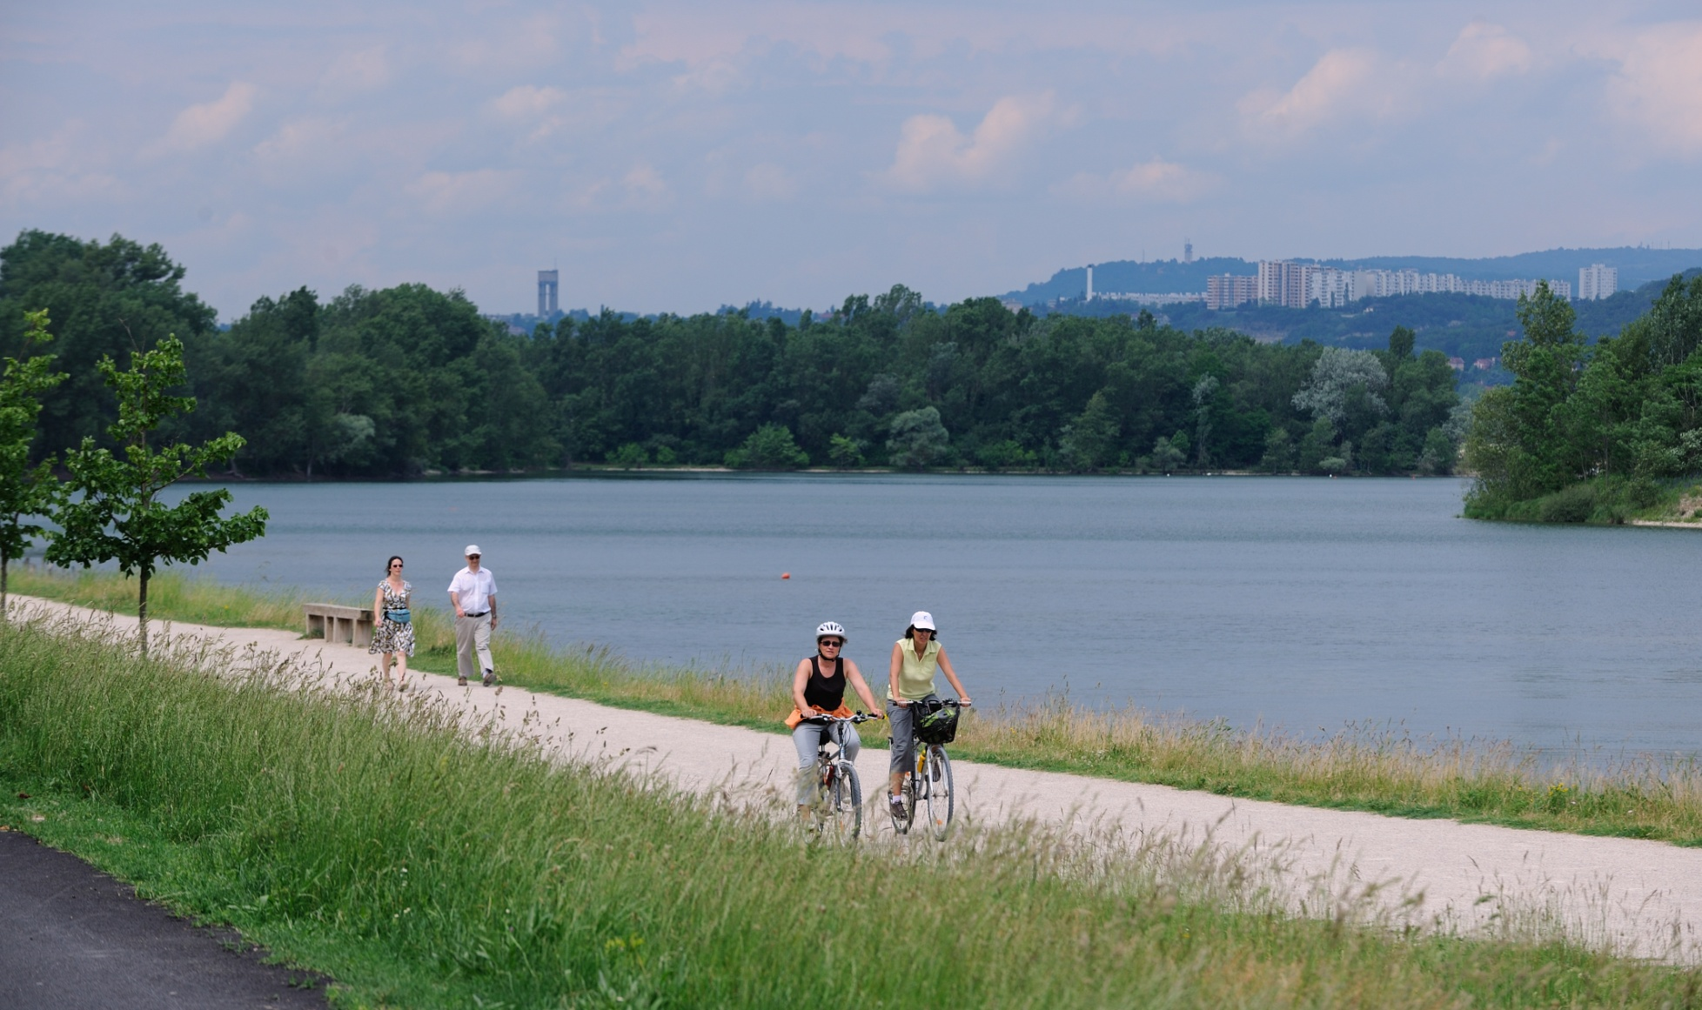
A park for the general public....
4 million visitors
6.5 times the size of Central Park
19th most popular French tourist site
Up to 50,000 people per day

Slide 5
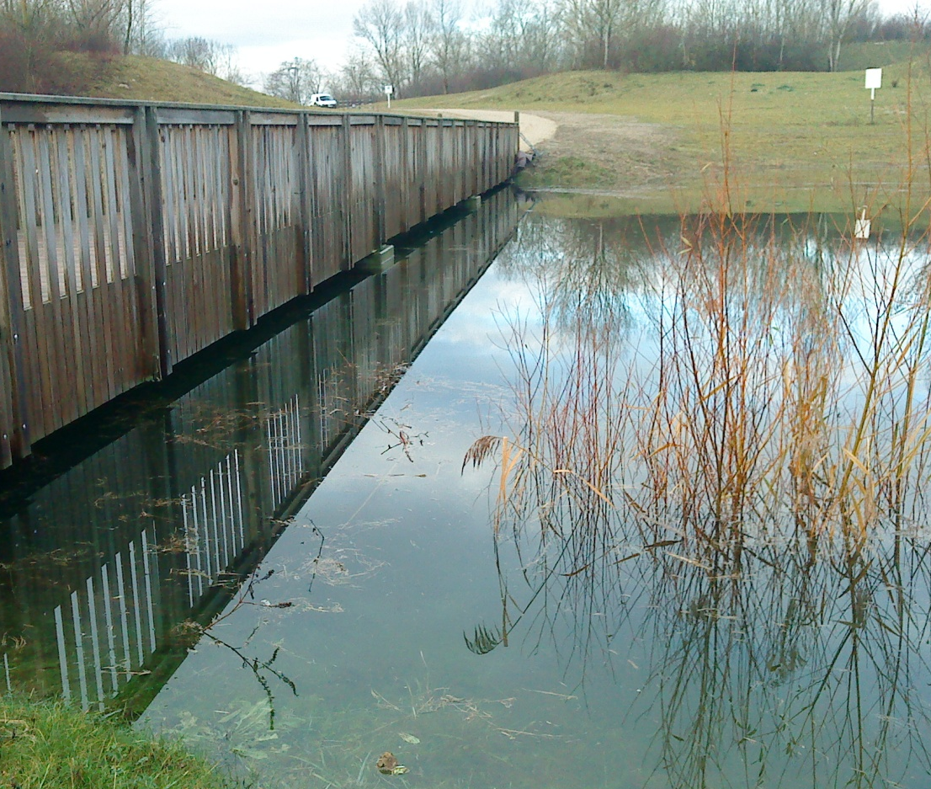
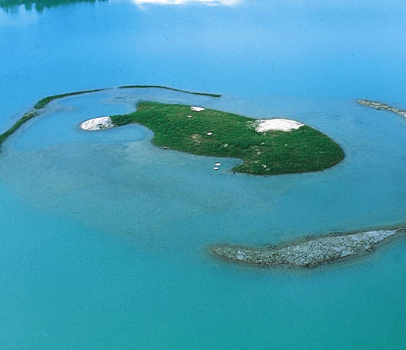
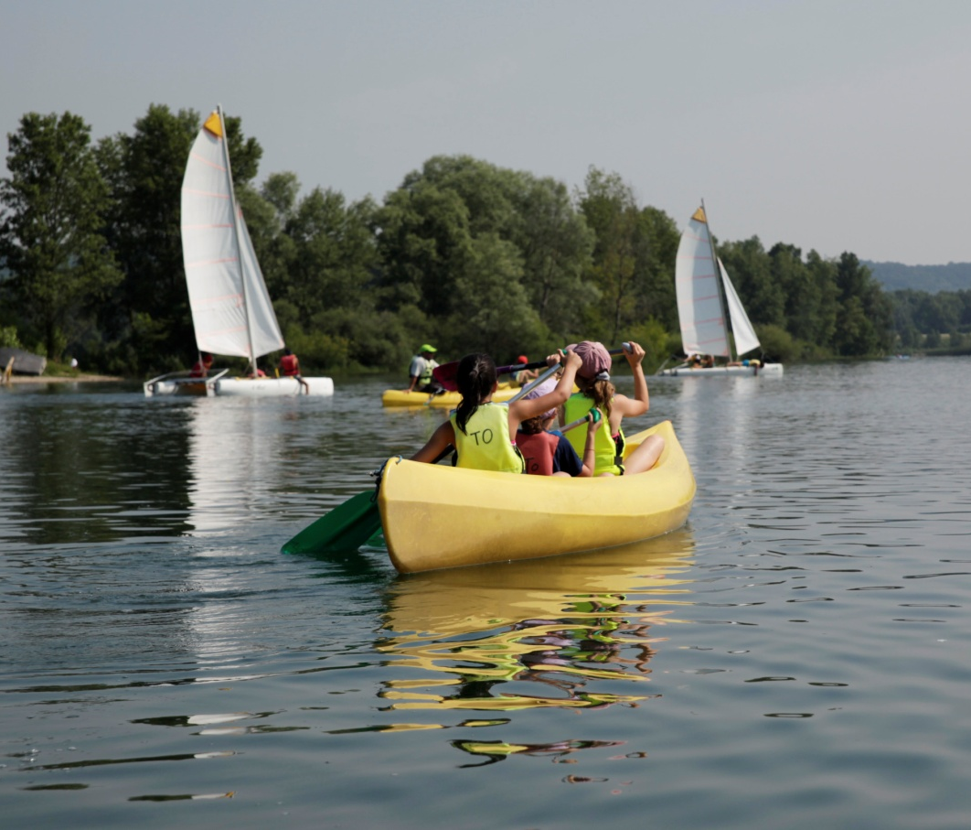
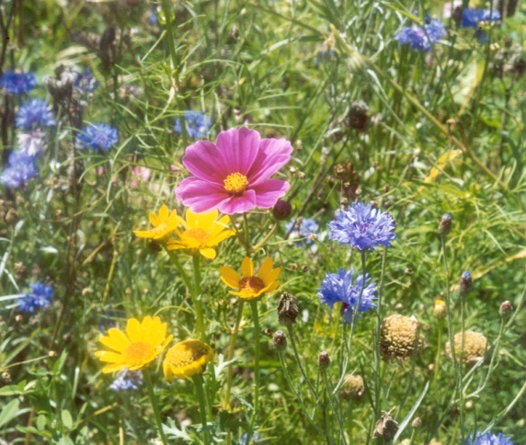
4 main priorities: Water at the heart of all plans

Slide 6
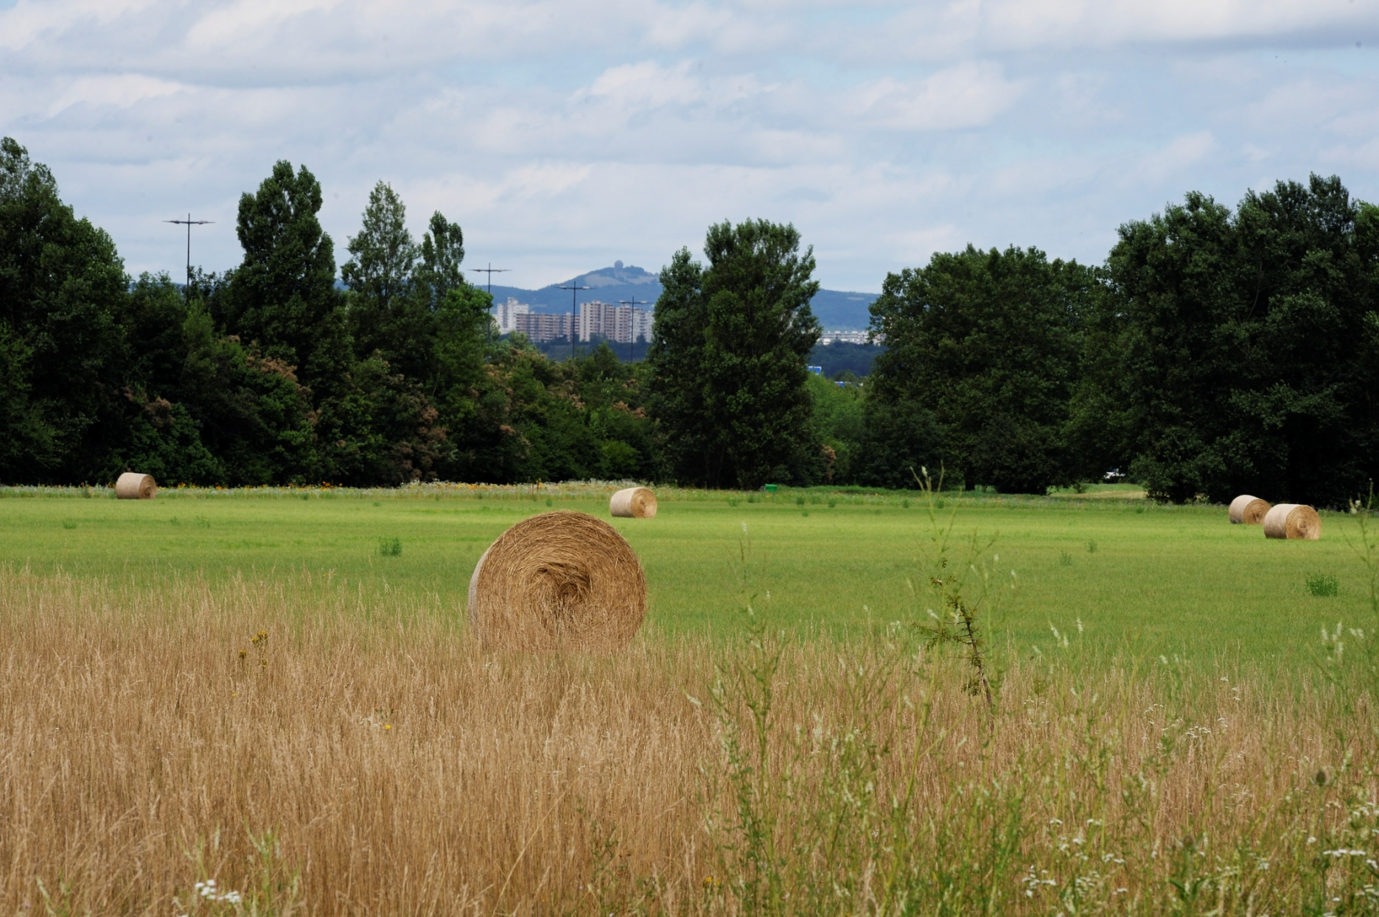
Coherence between agriculture in the park and the institutional environment

Slide 7
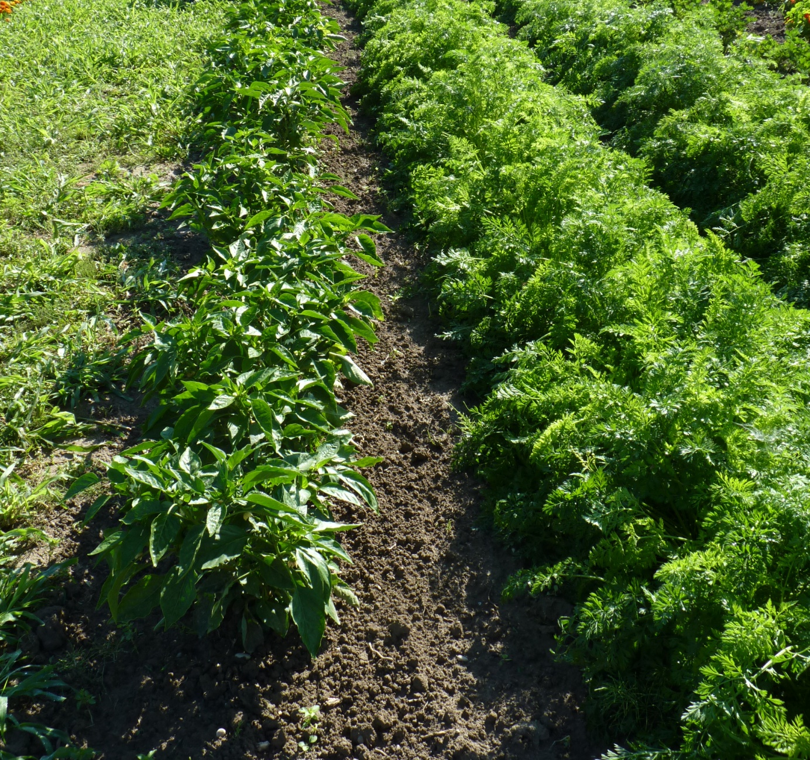
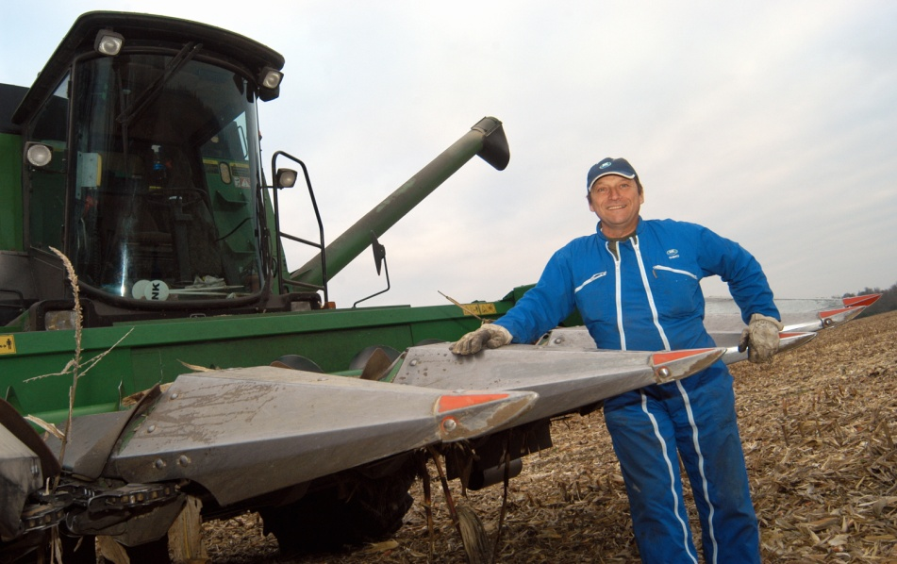
Agriculture in the Grand Parc in figures
990 acres (400 ha) of agricultural land
17 farmers
250 acres (100 ha) of natural meadows
Already 50% organically farmed
Between 2003 and 2013,
170 acres (70 ha) of large-scale
crops (maize, wheat) redeveloped

Slide 8
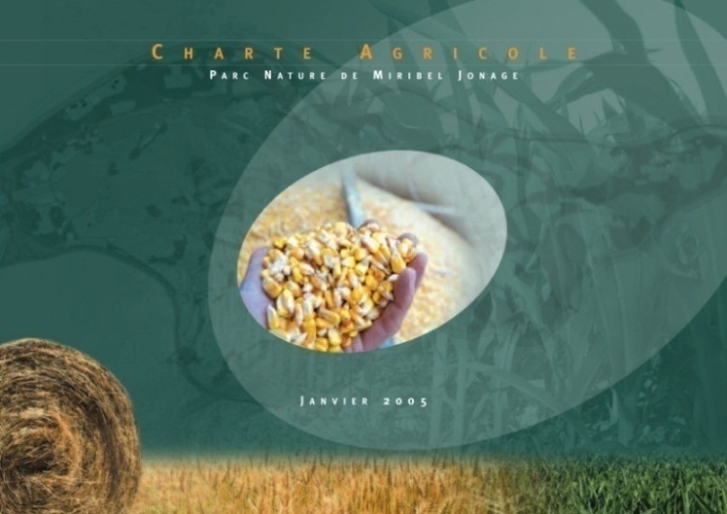
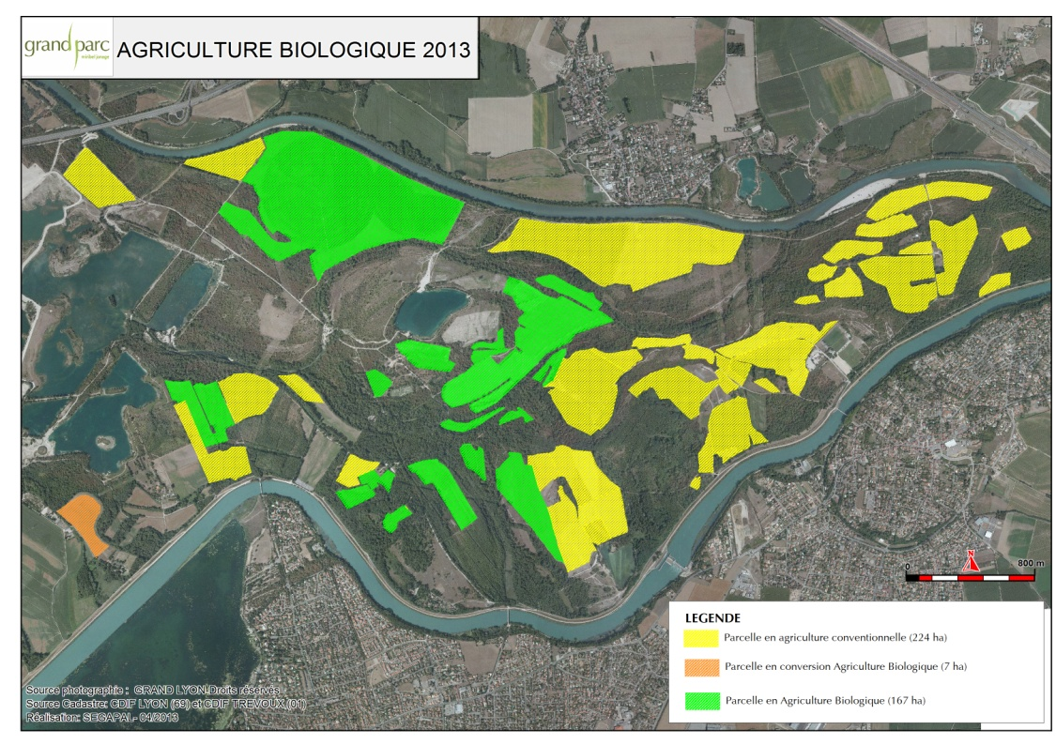
Current situation
Contracts signed for 10 years:
- Agreements for the temporary occupation
of public land
- Agricultural charter
Objective:
To continue with the same plans by developing practices that are in line with the sustainable development
objectives for the site.

Slide 9
What type of agriculture do we want?
To be an area of experimentation and a showcase for innovative practices on a regional scale in the following areas for development:
- Organic agriculture (pointing out the benefits to visitors)
- Pasture management
- Short supply chains (setting up chains/technical and economic feasibility)
- Market gardening

Slide 10
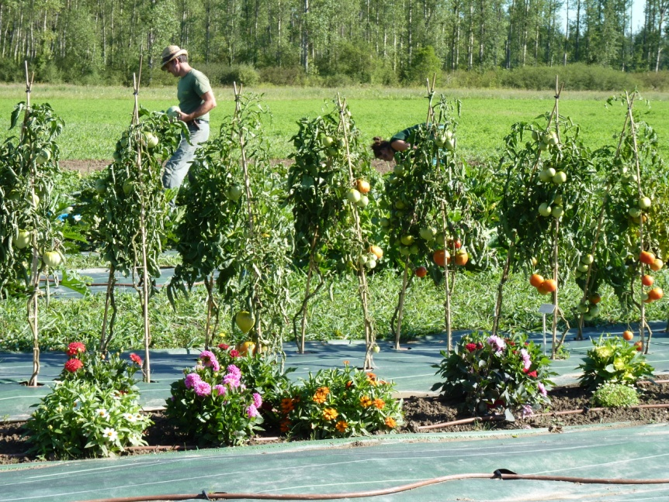
Why organic farming?
To fulfil the objectives that have been set
- Protect drinking water resources
- Preserve natural habitats
- Develop economic activity
- Contribute towards more healthy eating
Financial aid from the “Water agency” :
Support for farmers
Set up short supply chains
Point out the benefits of organic farming to visitors.

Slide 11
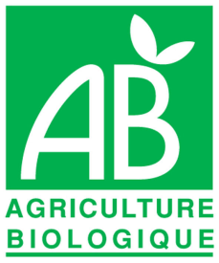

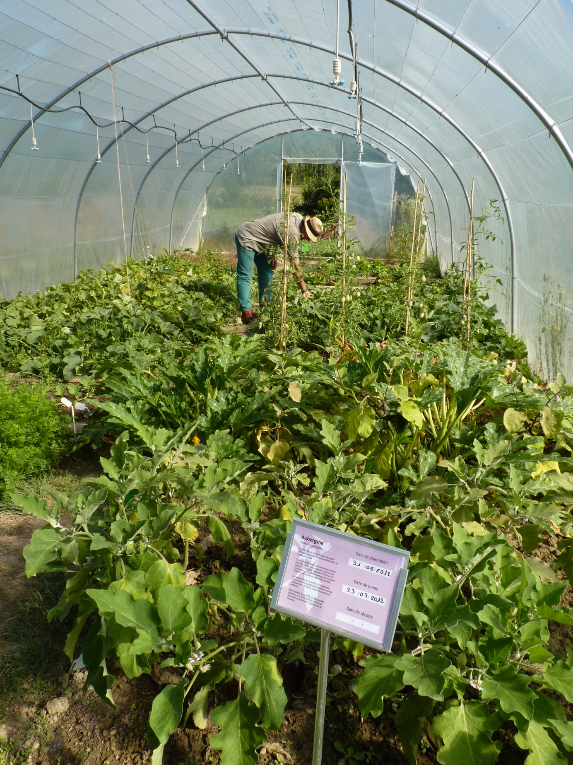
Organic farming in action
- Several farm visits organised by the park
- Diagnostics for converting to organic farming
- Conversion by 2 farmers
- Experiments with hemp
- Soil studies
Consultation concerning the new conventions between the farmers and the park
Organic certification for hay meadows (250 acres)
In 2014, organic farming in the park covers:
640 acres / 1200 (260 hectares / 500)

Slide 12
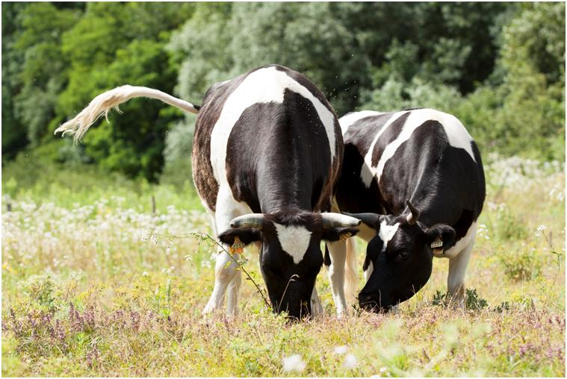
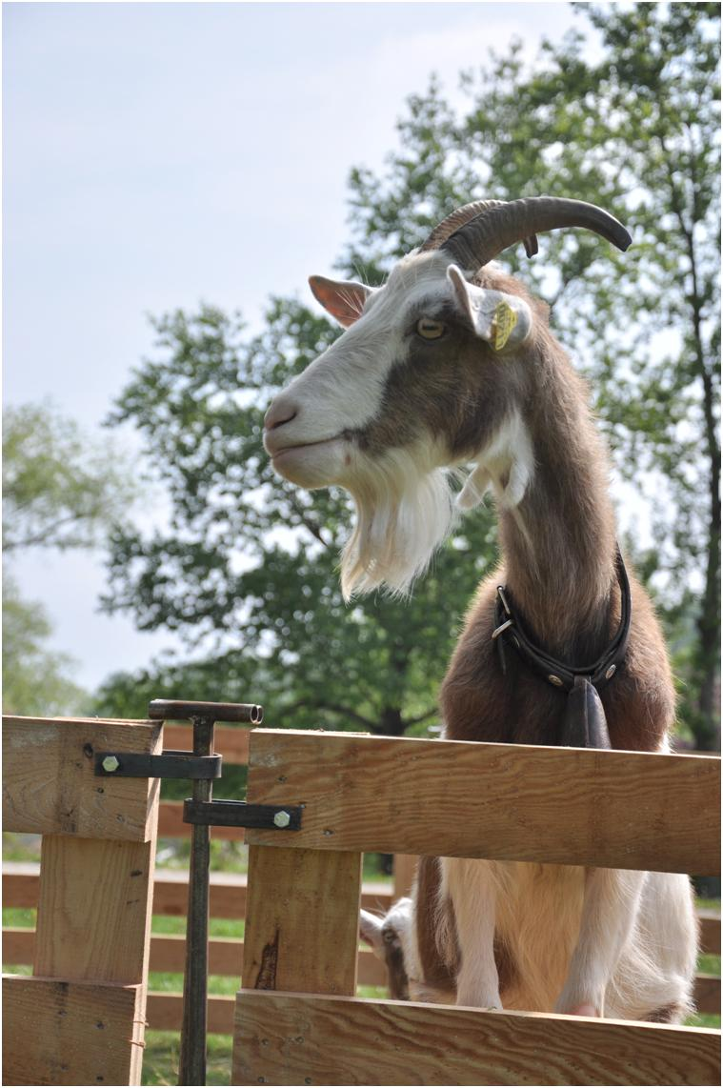
Pasture management in action
Acquisition of a herd of 15 cows / 30 goats

Slide 13
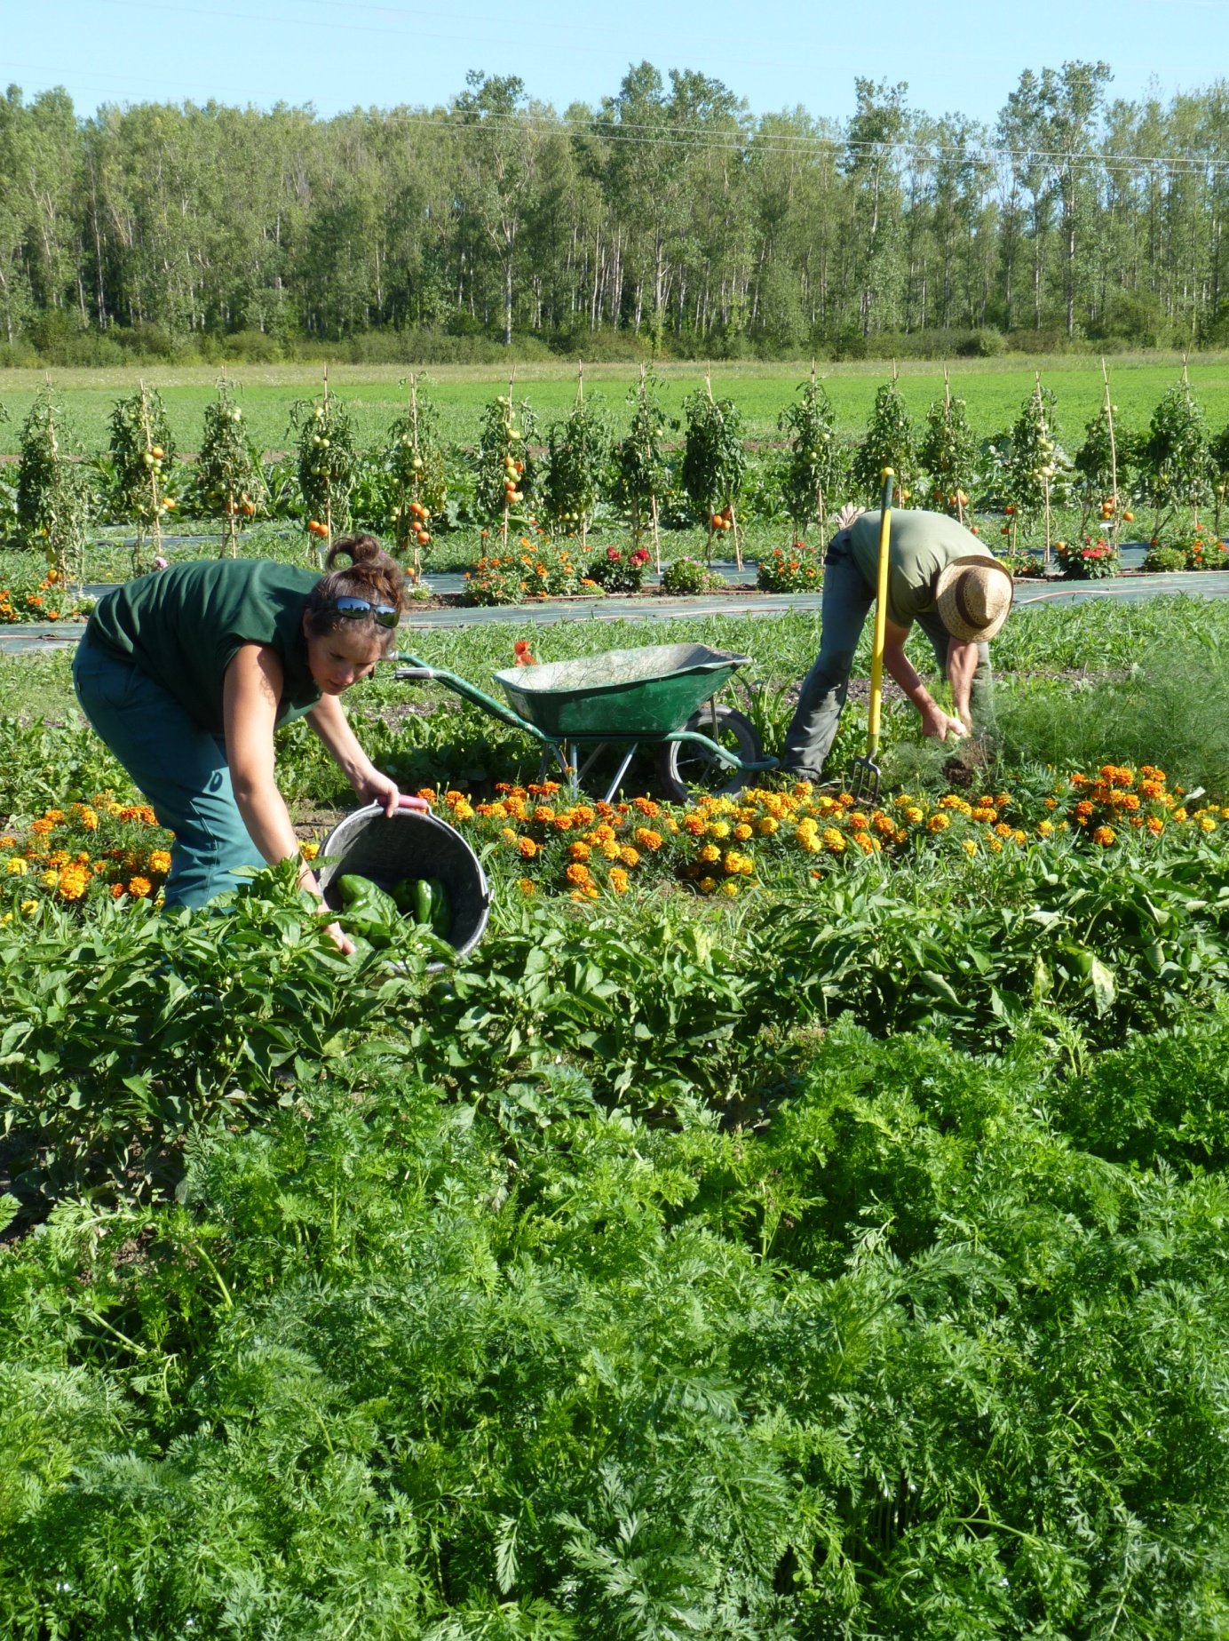
Why short supply chains?
- Enhancing the economic value of agricultural activity
- Enhancing the value of the agricultural land
Creation of a link between the producer
and the consumer
- Protection of the environment
Contributing towards more healthy eating.

Slide 14
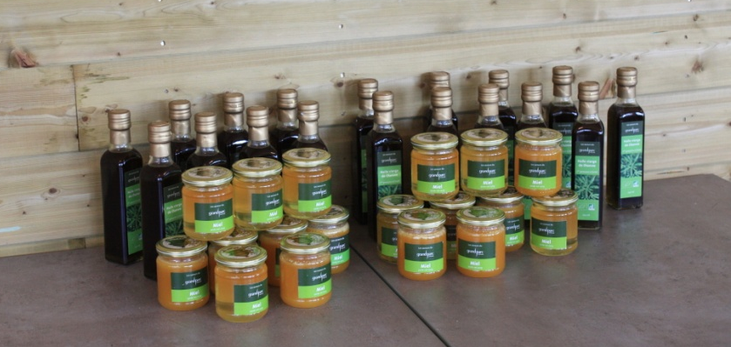
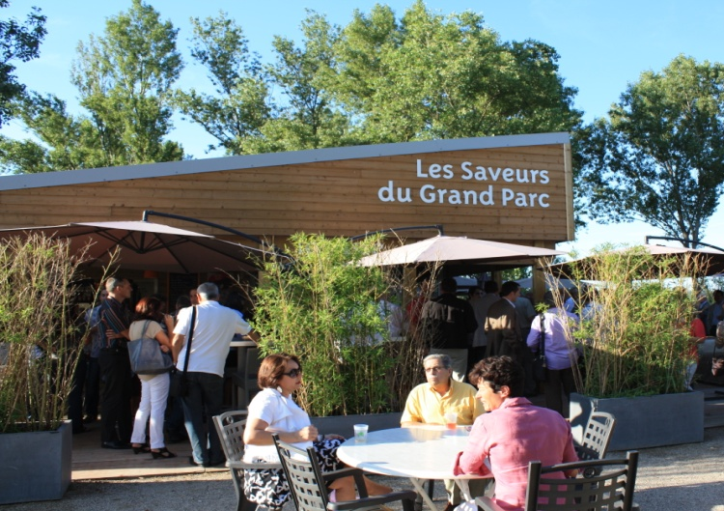
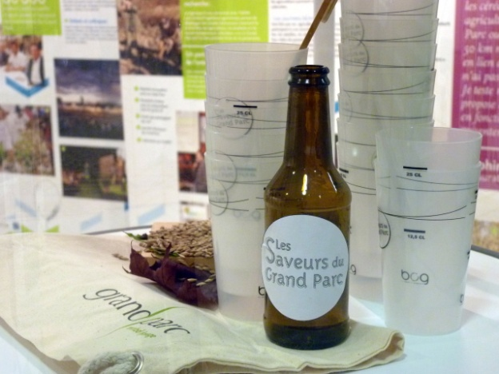
Short supply chains in action
2010: - Brand "Saveurs du Grand Parc"
- Award of "LVED" (sustainability and fair-trade for Lyon) label
2011: - Partnership with Woodstower for the supply of vegetables
- First "Saveurs du Grand Parc" honey produced
2012: - Opening of the
"Les Saveurs du Grand Parc"
restaurant
2013 : Production of
organic beer

Slide 15
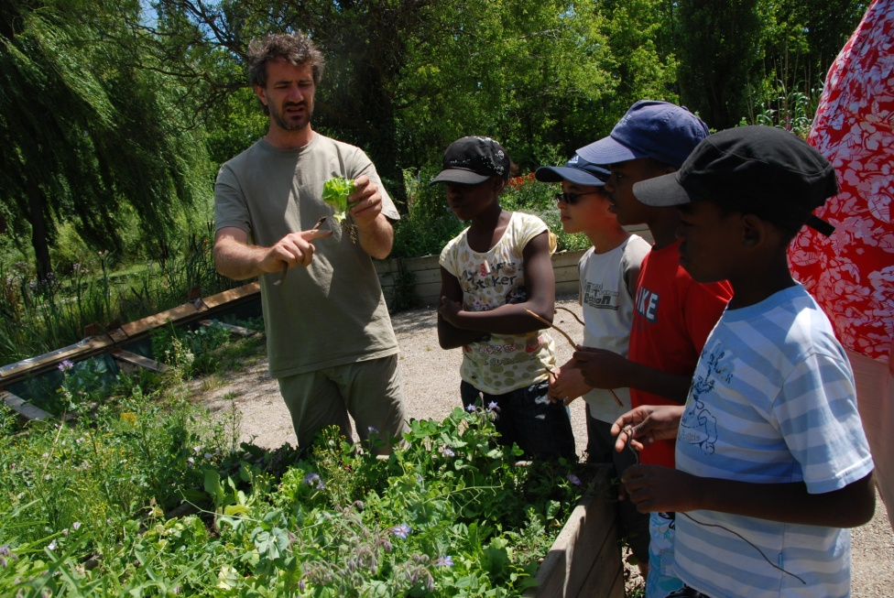
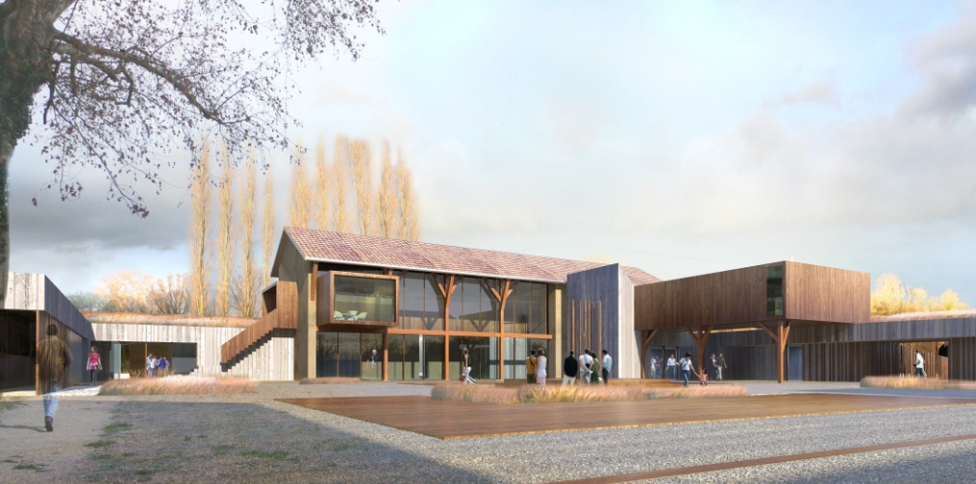
Why market gardening?
- Diversify agricultural production
- Enhance the value of the agricultural land in the park
Contribute towards more healthy eating
- Creation of a link between the producer and the consumer
Attach educational value to this work,
in partnership with L’îloz’
To achieve this, Organic farming is a priority.

Slide 16
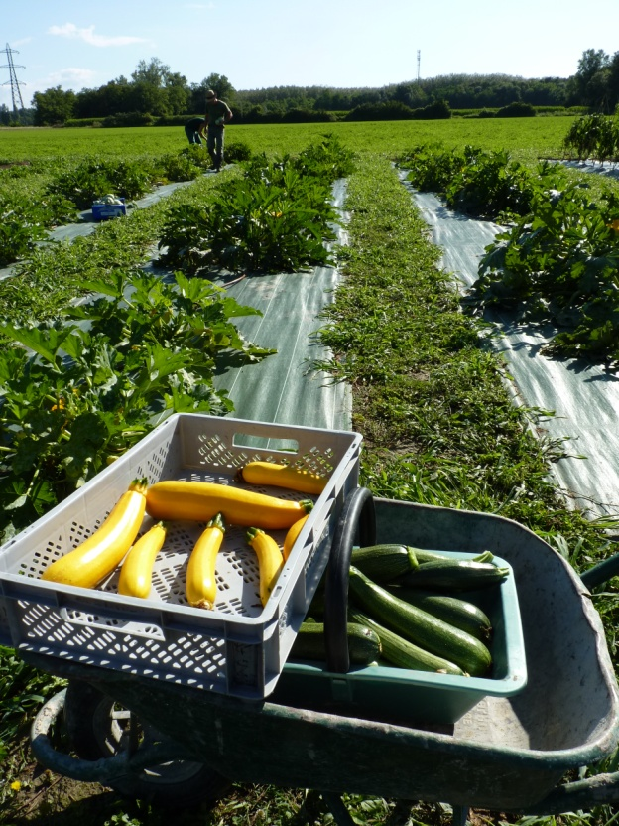
Conditions for the success of the development of market gardening and short supply chains
Need for irrigation network
Proximity of storage sites
Sales and marketing chains
Good accessibility
Management of the presence
of the general public

